Slide 1

Tech Challenge Case - Study
2022-2023(NSEIT)
Live: https://projectify-beta.vercel.app/

Slide 2
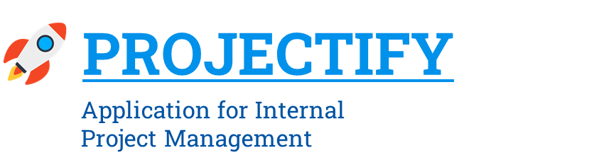

Slide 3
Group Name – Tech Warriors
Group Members Name:
Sanjukta Das
Debraj Karmakar
Nayanika Nandi
Hemant Tiwari
Purunendu Purnesh
MD Ahtesham Ahmad
Diptanu Ghosh
- Guided by Natarajan Ramachandran

Slide 4
CONTENTS
Introduction
Definition of the problem addressed
Tech Stack requirement
Work Flow Diagram
Data Flow Diagram
Design or Key Constructs
Actual Code
Key outcome(Case Study)
Conclusion & Future Scope

Slide 5
Topic Name: Application for Internal Project Open Positions
INTRODUCTION
The proposed idea for this presentation is to explore the potential of an internal project management system.
We will examine how such a system can be designed to improve organization and communication, while weighing the tradeoffs associated with relying on manual processes over automated ones.
Additionally, we will discuss the ethical considerations of deploying manual processes versus automated ones, and consider the potential for a hybrid approach that takes advantage of both.

Slide 6
Problem addressed
Build an internal project management system so that organizations no longer need to depend on third party software and are able to manage their own projects by themselves.
Platform designed needs to facilitate the part of creating, maintaining and assigning projects smoothly and efficiently.

Slide 7





















Tech Stack
Frontend
Tools
Backend
Hosting

Slide 8
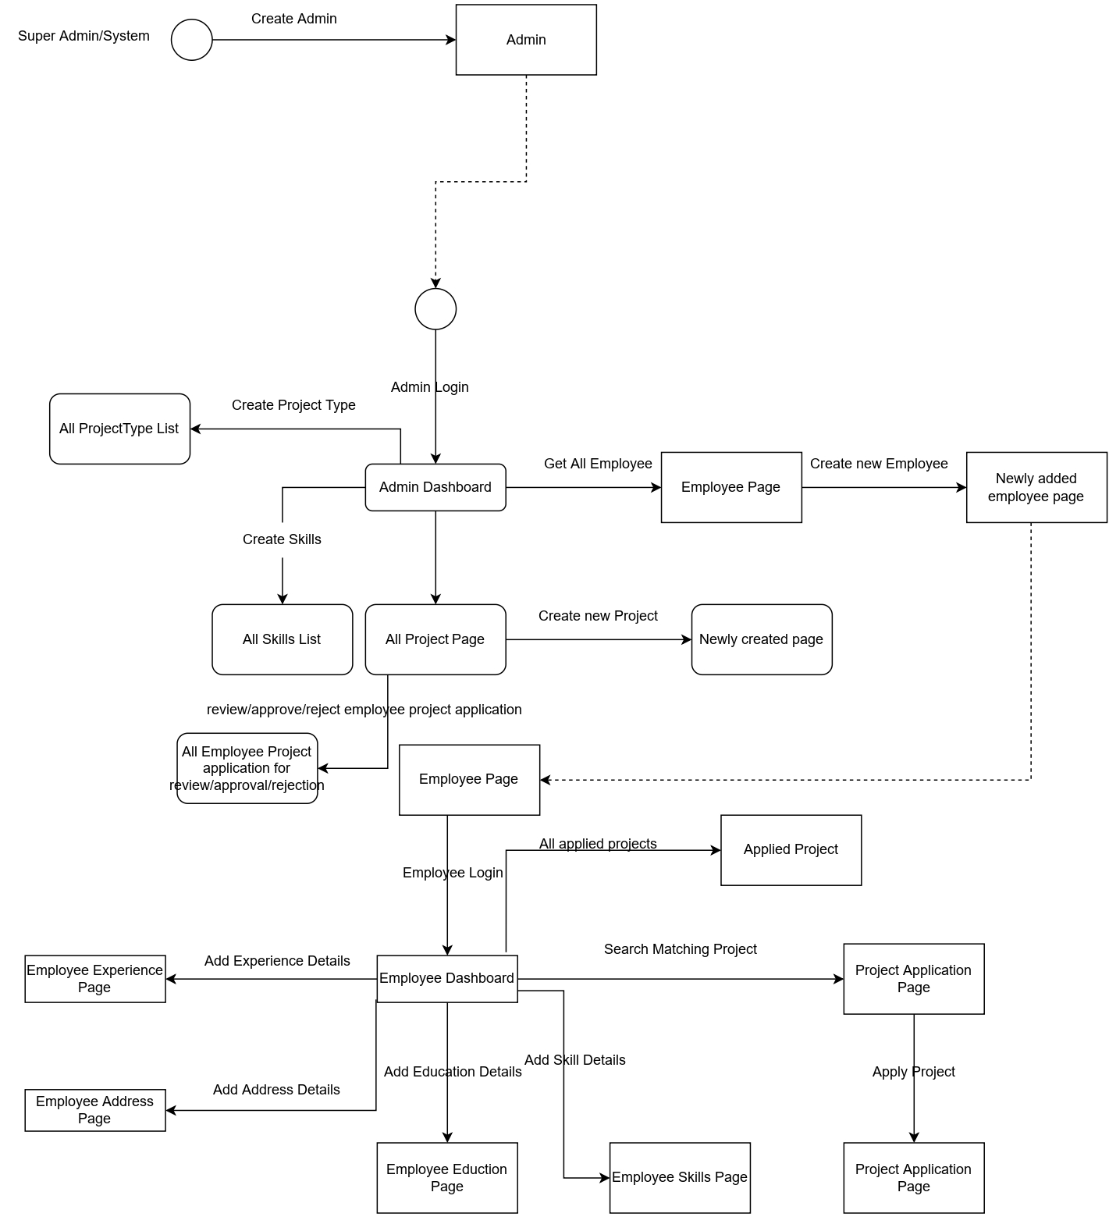
Work flow

Slide 10
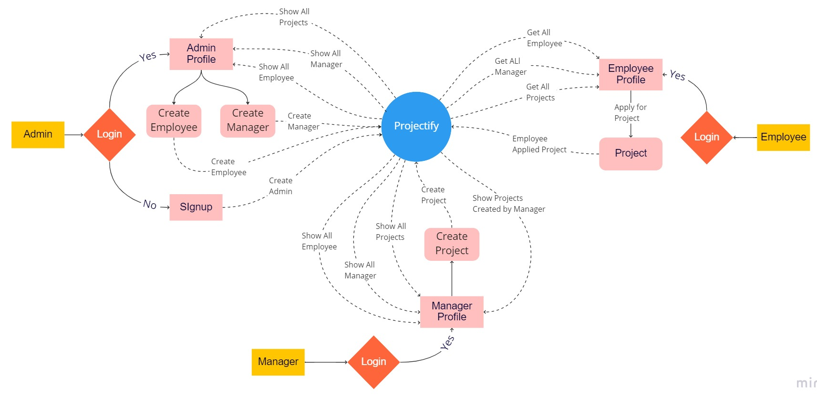
Data Flow Diagram

Slide 11
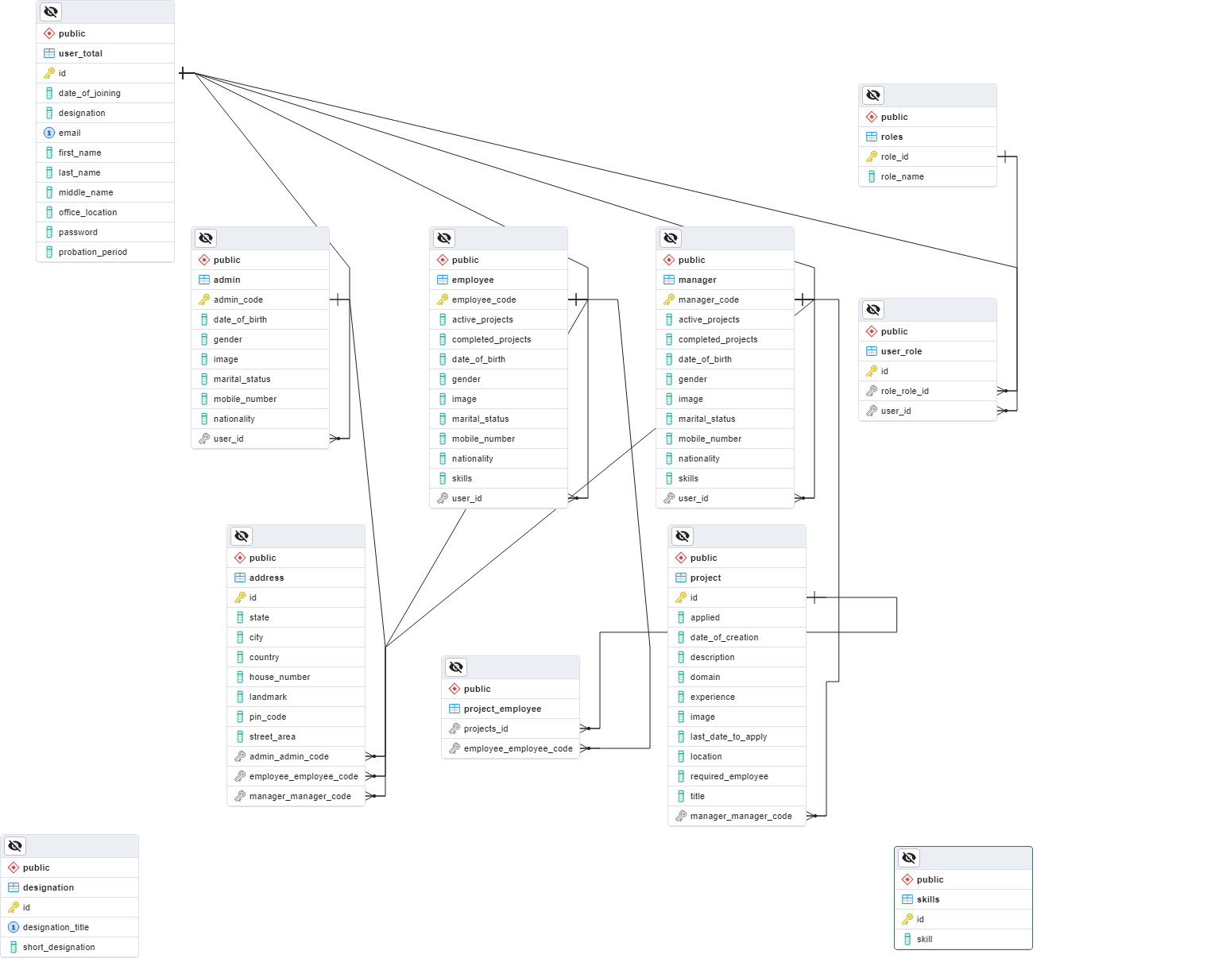
ER Diagram

Slide 12
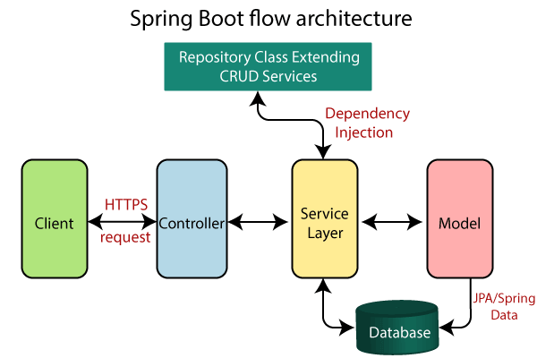
Spring Boot Architecture
The Spring Boot is built on top of the core Spring framework. It is a simplified and automated version of the spring framework. The spring boot follows a layered architecture in which each layer communicates to other layers. Spring Boot makes it easy to create stand-alone, production-grade Spring based application.

Slide 13
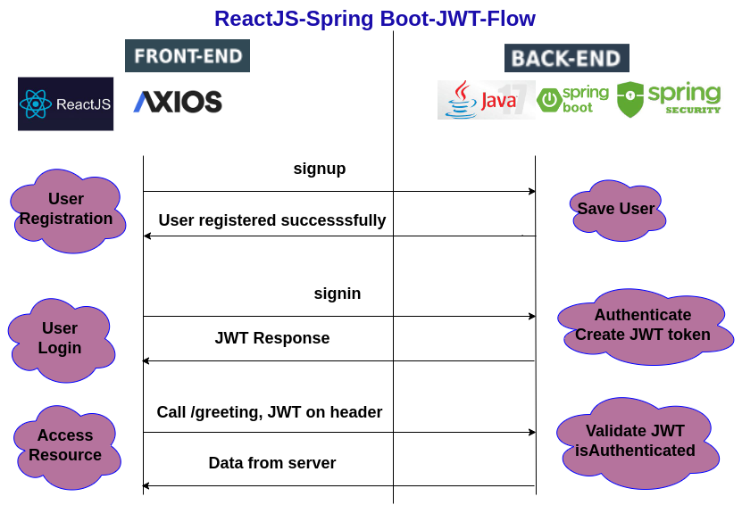
JWT Flow in Projectify

Slide 14
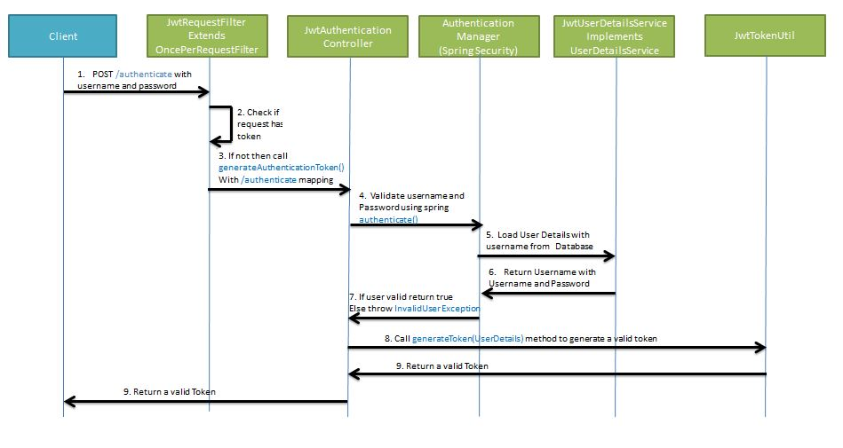
Generate JWT

Slide 15
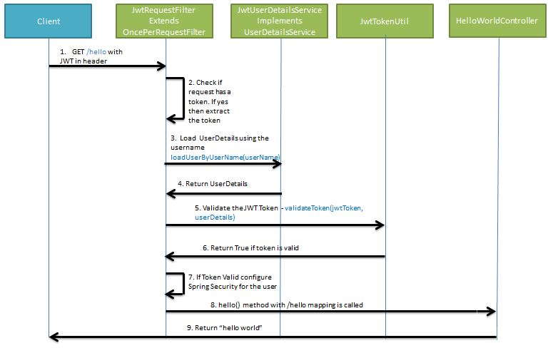
Validate JWT

Slide 16
Encrypt Password
In this project we have used BCryptPasswordEncoder.
BCryptPasswordEncoder is an encryption algorithm developed to securely store user authentication information. It is based on the Blowfish cipher and uses a large randomly-generated salt value to increase its security. This algorithm is often used in combination with SpringBoot to provide secure user authentication functionality.

Slide 17
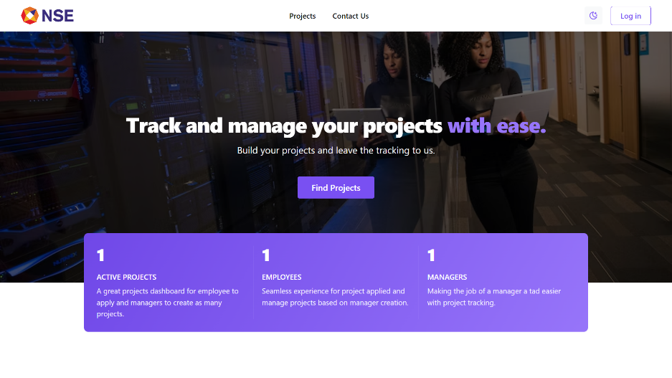
Design or key constructs
HOME PAGE:
This is the home page of our web application Projectify. Here we can login or look at the projects page or the contact page. The other pages however require the user to be logged in.

Slide 18
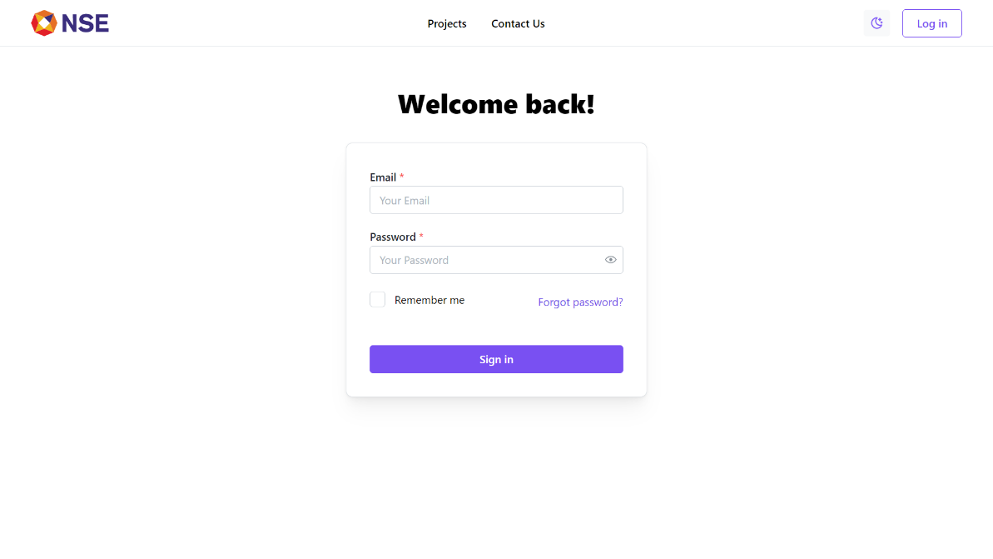
Design or key constructs
LOGIN PAGE:
This is the login page of Projectify, from here we can login to our accounts. The type of account that we are logging in through will determine the access level of the user.

Slide 19
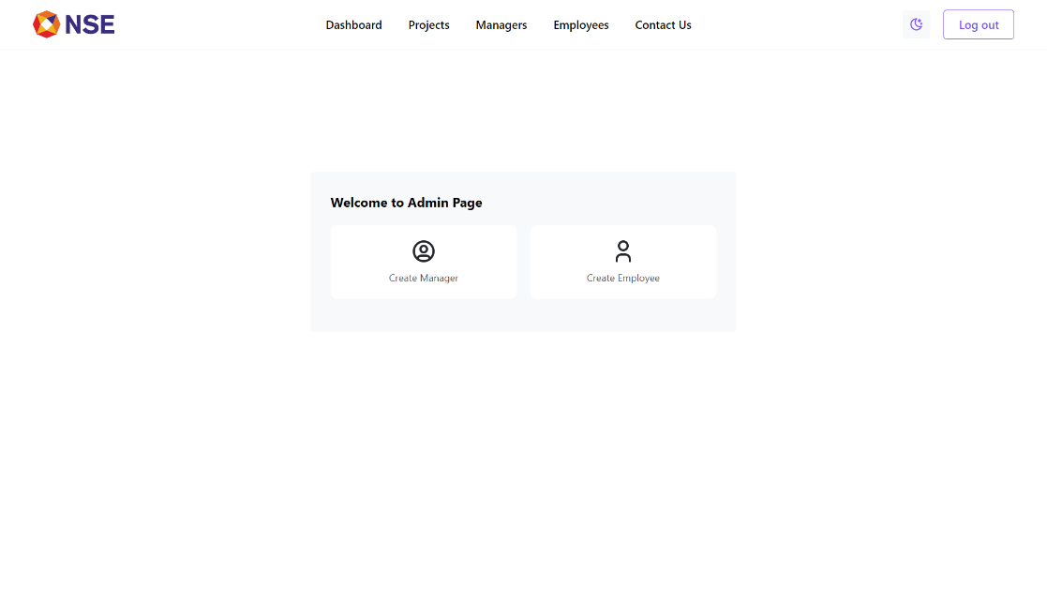
Design or key constructs
Dashboard:
After login, a dashboard page will be displayed based on the account which has logged in.

Slide 20
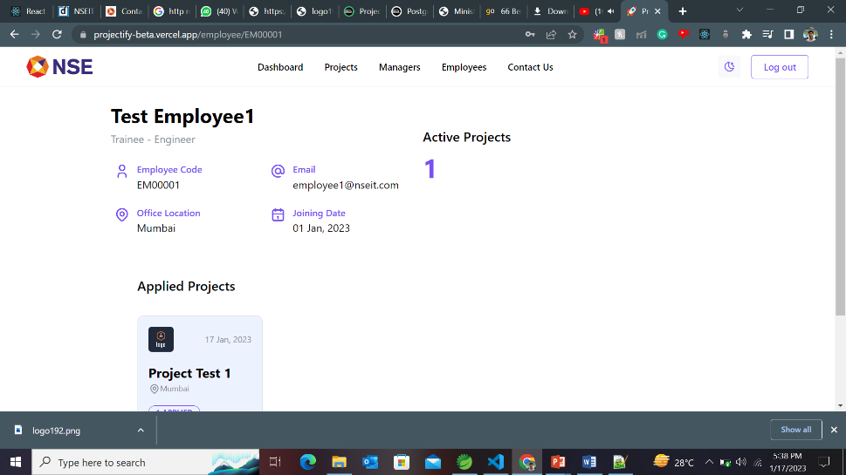
Design or key constructs
Details Page:
Depending on the type and account the dashboard pages will either show the requested details.

Slide 21
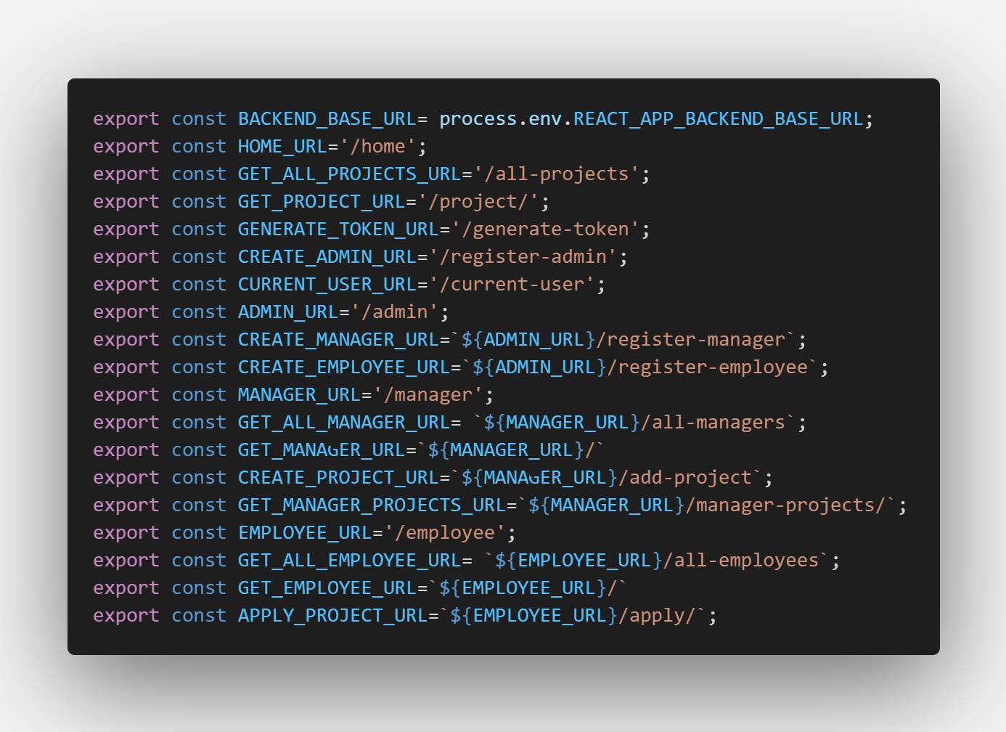
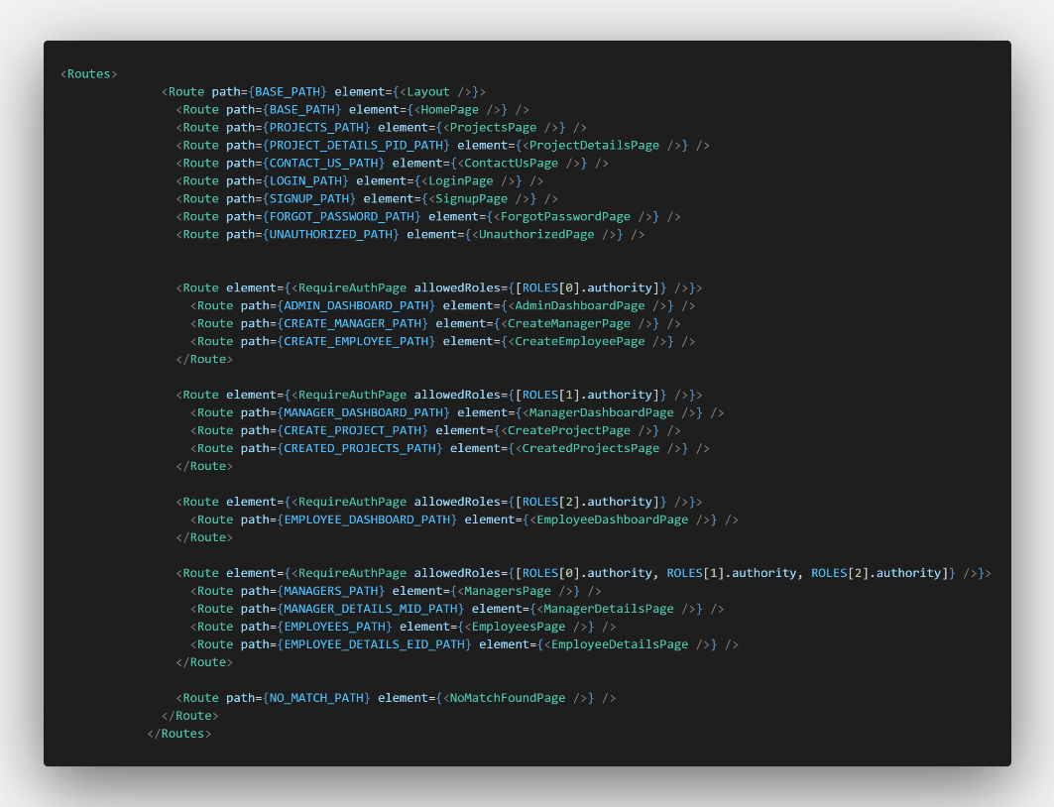
Actual Code
APIs Used
Protected Route based on User Role

Slide 22
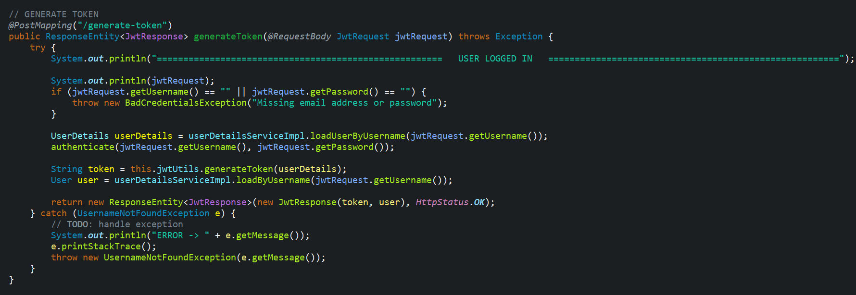
Login Generate Token

Slide 23
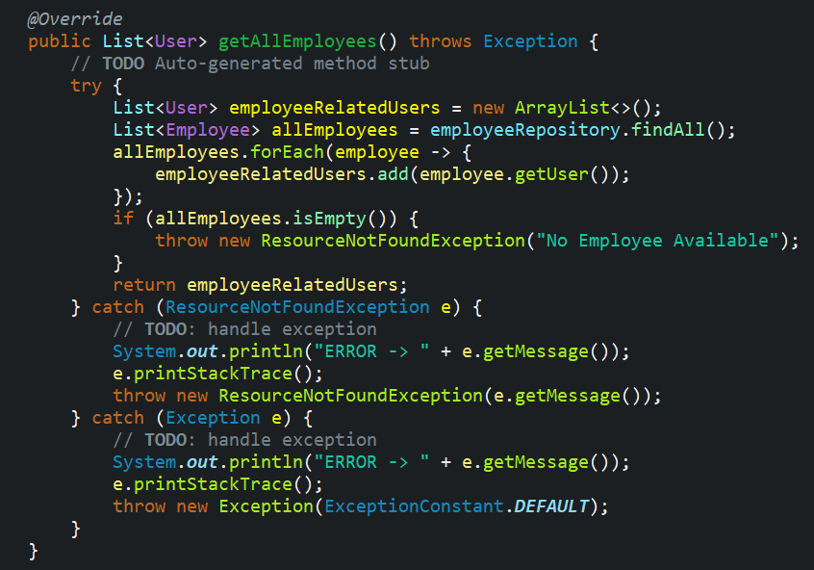
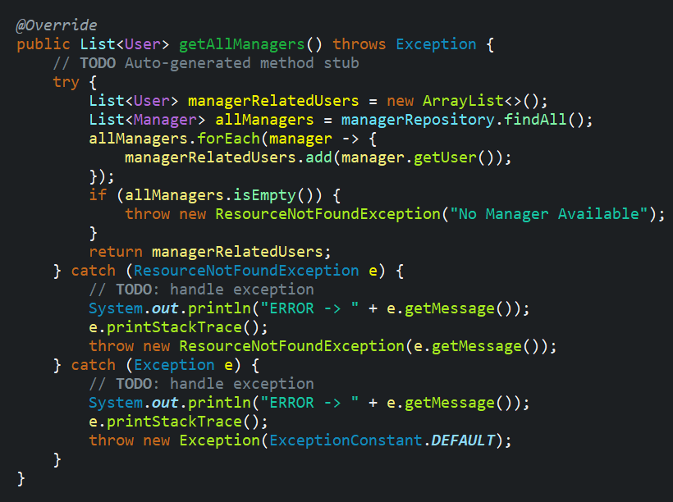
Get All Employee
Get All Manager

Slide 24
Key Outcome (Case Study)
This case study explores the project management side of an organization. The application developed by us can be used by the organization to stop relying on third party software for their project management needs. As the organization grows in size, its reliance on the third party software also grows. Our work is aimed to eliminate that very reliance and make the organization self sufficient.

Slide 25
Conclusion & Future Scope
By implementing Projectify web app an organisation can automate their process of tracking projects.
Managers can create and keep track of their projects easily.
Our role-based authentication adds an additional layer of security by blocking access to certain pages based on the level of authority.
Projectify has a user friendly responsive UI with both light and dark modes.
More functionalities like skill base project mapping, assigning tasks, and tracking the progress of each employee will be added in the near future.

Slide 26
THANK YOU

